Slide 1

Module 3 Review
Rayid Ghani and Kit Rodolfa

Slide 2
Final Write-Up
Due next Wednesday, December 14
https://canvas.cmu.edu/courses/31332/assignments/515862

Slide 3
Data and AI Ethics Issues
Privacy
Data Ownership
Bias, Equity, & Fairness
Transparency
Trustworthiness and Accountability

Slide 4
Many Bias Measures: How do we select what we care about?
Statistical/Demographic Parity
Impact Parity
False Discovery Rate Parity
False Omission Rate Parity
False Positive Rate Parity
False Negative Rate Parity
...

Slide 5
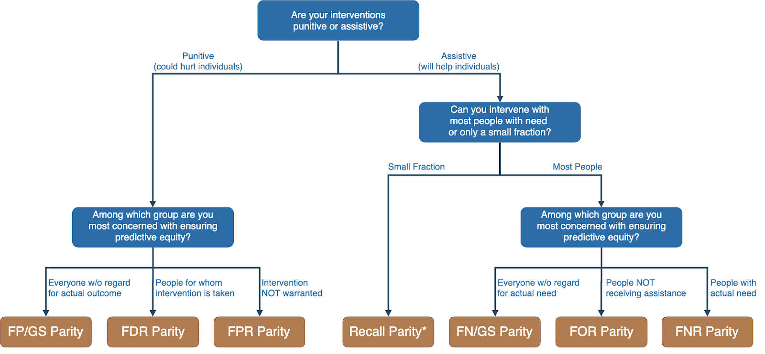
Translating policy goals to fairness metrics

Slide 6
How can we reduce bias in ML models?
Fix the world
Pre-Processing: Fix the input data
Remove sensitive attributes (and correlated ones)
Resample and/or reweight protected groups
In-Processing: Optimize for fairness in model training
Post-Processing
Choose fair models during model selection
Post-hoc adjustments to ‘de-bias’ model scores

Slide 7
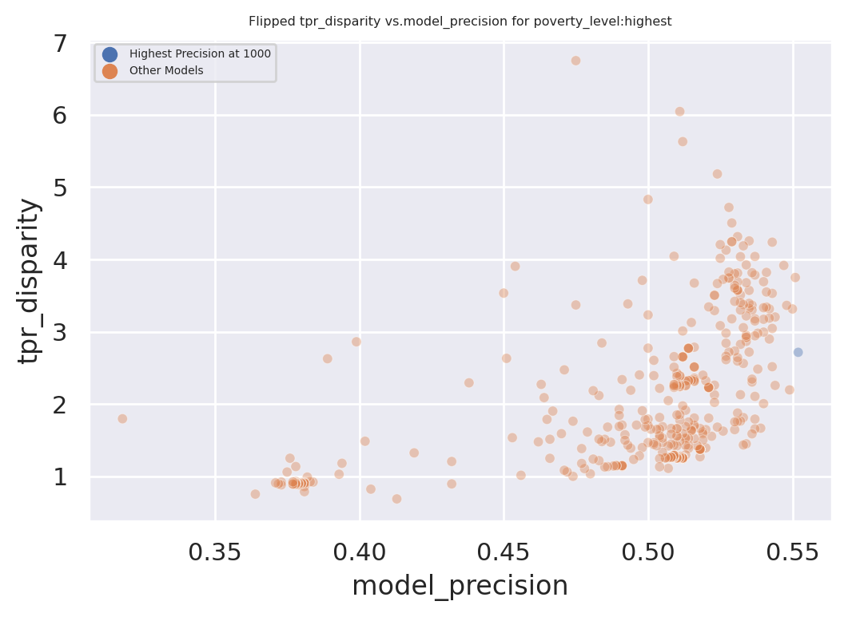
Dual Goals: Fairness and Accuracy
Disparity
Our hope:
Fairness-improving
methods can expand this
frontier by adding new
points
Precision@k

Slide 8
Pre-Processing Methods
Looked at removing sensitive attributes and resampling
What are the key assumptions behind each approach?
How well did they work in practice?
Areas for improvement or future research?

Slide 9
In-Processing Methods
Looked at methods from Zafar, Celis, and FairLearn
What are the key assumptions behind each approach?
How well did they work in practice?
Areas for improvement or future research?

Slide 10
Post-Processing Methods
Looked at model selection, decoupling, score adjustments
What are the key assumptions behind each approach?
How well did they work in practice?
Areas for improvement or future research?

Slide 11
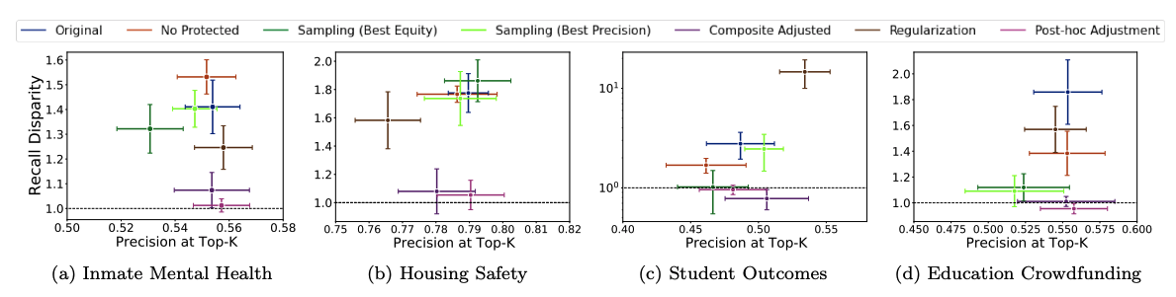
Comparing Methods Across Problem Settings

Slide 12
Post-Processing
Case Study

Slide 13
Case Study: Post-hoc Adjustments and Policy Goals
Cycle of Incarceration
UNMET
NEEDS
MISDEMEANOR
ARREST
JAIL
worsening or failing to improve

Slide 14
Case Study: Post-hoc Adjustments and Policy Goals
Breaking the Cycle
UNMET
NEEDS
X
MISDEMEANOR
ARREST
JAIL
TAILORED
INTERVENTION

Slide 15
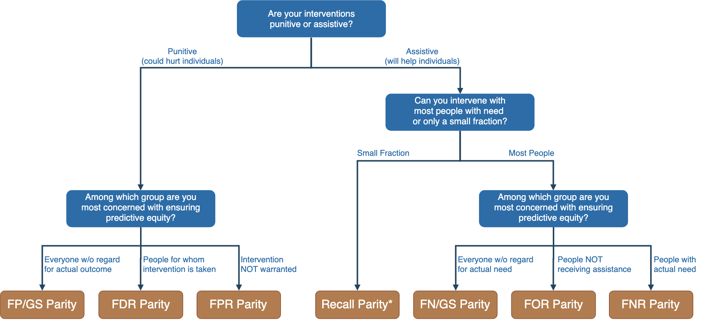
Notes:
Context-dependence of fairness definition
Idea of fairness tree is starting point for conversations with stakeholders, help guide discussion
In assistive program with resource constraints, focus on recall parity (equivalent to equality of opportunity discussed by Hardt and others --- also “sensitivity” and TPR and 1-FNR)

Slide 16
Notes:
Context-dependence of fairness definition
Idea of fairness tree is starting point for conversations with stakeholders, help guide discussion
In assistive program with resource constraints, focus on recall parity (equivalent to equality of opportunity discussed by Hardt and others --- also “sensitivity” and TPR and 1-FNR)

Slide 17
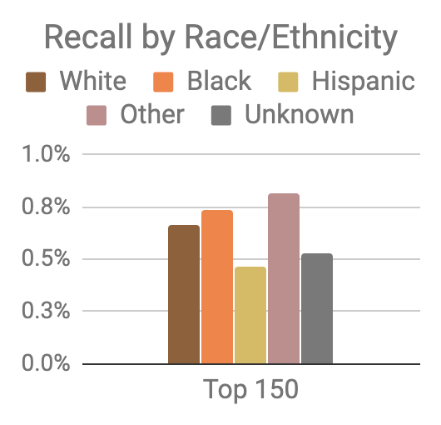
Model was optimized for efficiency, not equity
Top 150 highest risk reasonably balanced between black and white individuals
However, hispanic and unknown race/ethnicity groups very underrepresented

Slide 18
Mitigating Disparities
Single Threshold
White
Black
Hispanic
Recall
Lower Scores / Higher Recall
Group Thresholds
Recall

Slide 19
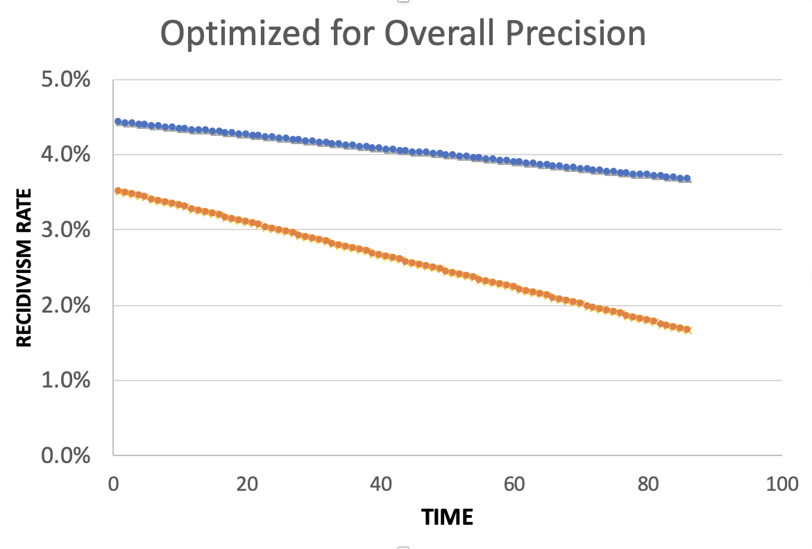
Equality of Predictions vs Underlying Disparities
Widening Gap:
Disparities Getting
Larger Over Time

Slide 20
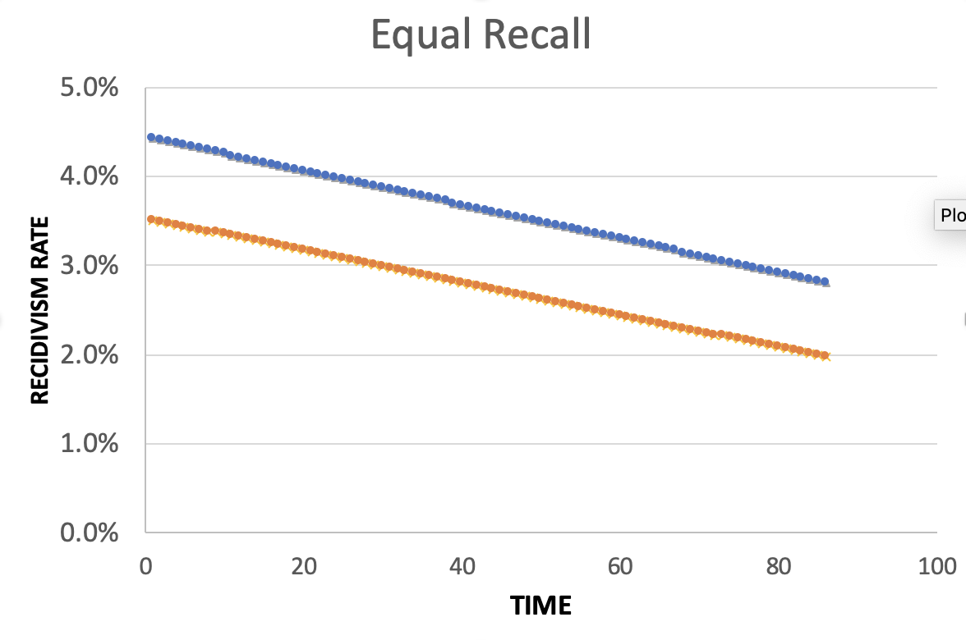
Equality of Predictions vs Underlying Disparities
Parallel Lines:
Disparities Remain
Constant Over Time

Slide 21
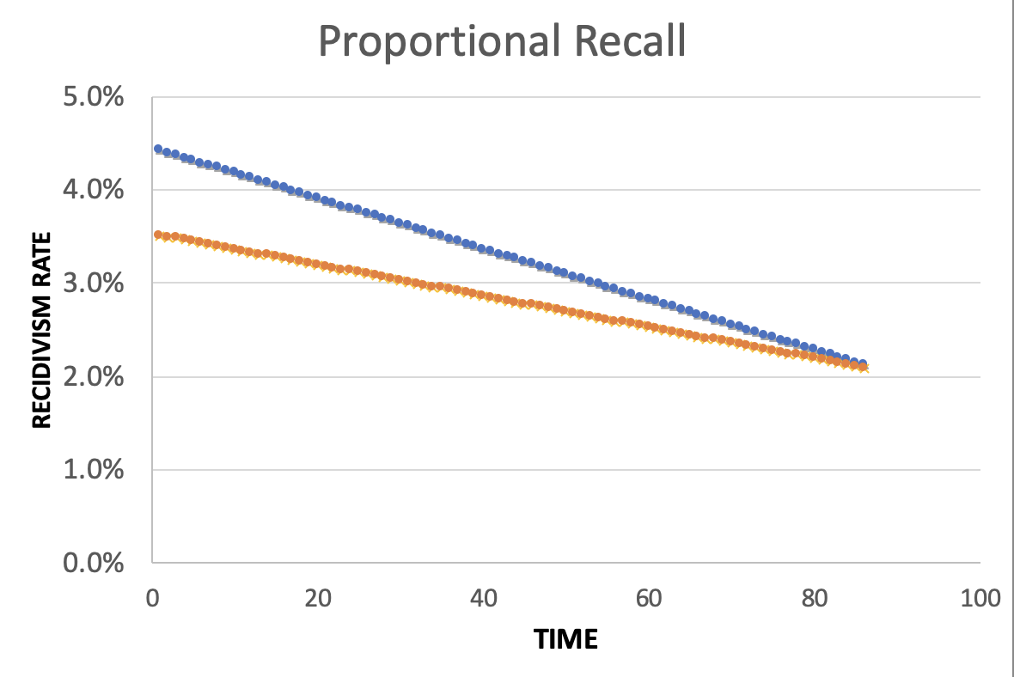
Equality of Predictions vs Underlying Disparities
Converging Lines:
Disparities Decrease
Over Time

Slide 23
Menu of Options
Current Scale
Expanded Scale
No
Constraint
Equalize
Recall
Reduce
Disparities

Slide 24
Menu of Options
Current Scale
Expanded Scale
No
Constraint
INITIAL
MODEL
Equalize
Recall
Reduce
Disparities

Slide 25
Menu of Options
Current Scale
Expanded Scale
No
Constraint
Equalize
Recall
EXPLICIT
EQUITY / EFFICIENCY
TRADE-OFF
“COST OF
EQUITY”
Reduce
Disparities

Slide 26
Menu of Options
Current Scale
Expanded Scale
No
Constraint
Equalize
Recall
IMPROVE OUTCOMES AT SAME
RATE ACROSS GROUPS
Reduce
Disparities
IMPROVE OUTCOMES FASTER FOR GROUPS
WITH HIGHER INCARCERATION RATES
Notes:
For the “Reduce Disparities” options, we targeted recall levels in proportion to underlying prevalence in the population. Could make other choices, but this has the nice property of readjusting as these prevalences change while also still distributing resources across all groups, but one could reasonably take many possible approaches.

Slide 27
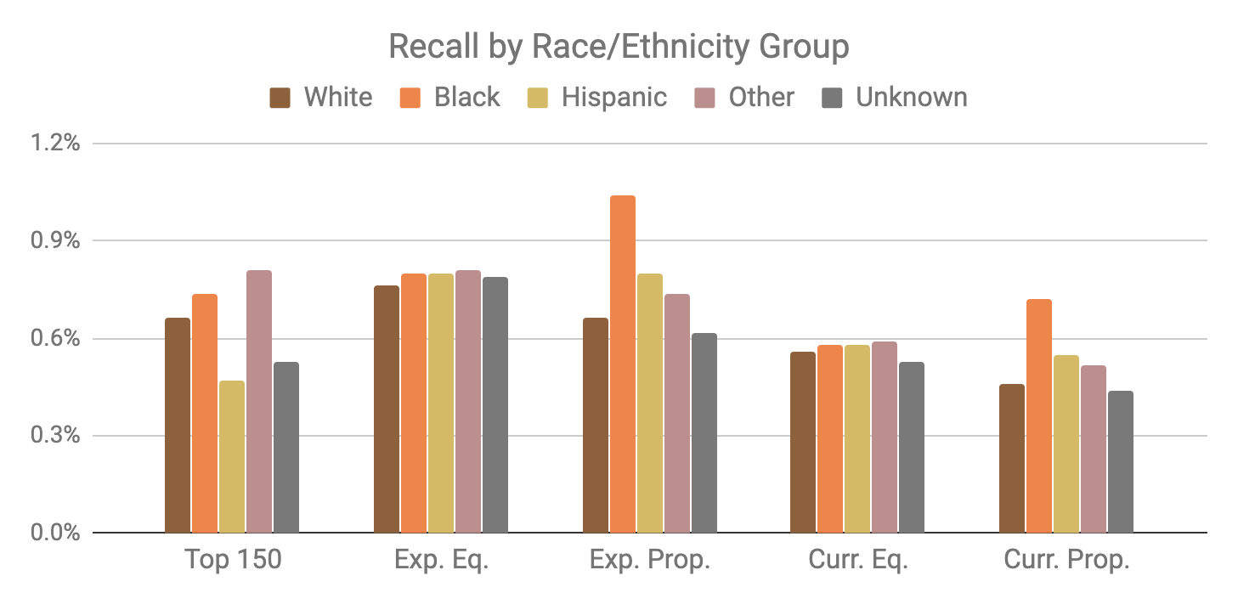
Base Model
Expanded Scale
Current Scale

Slide 28
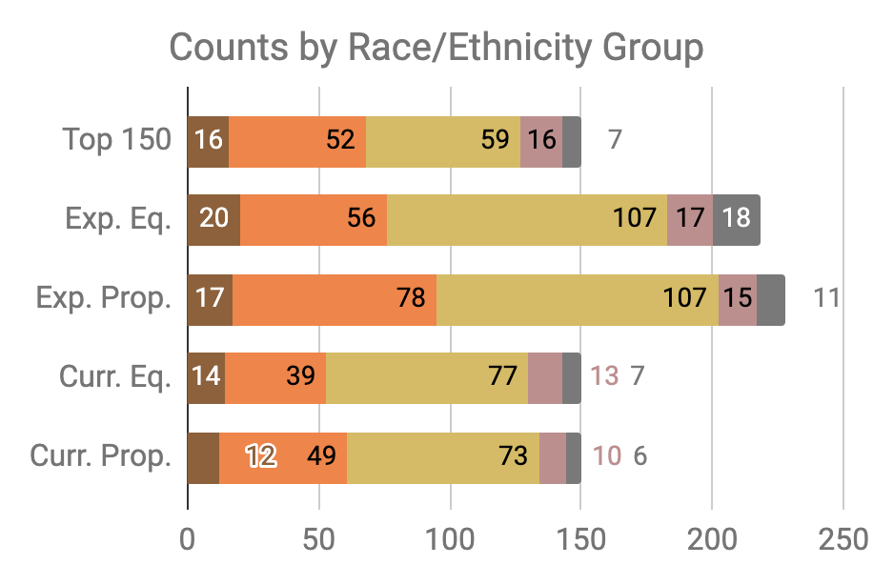

Slide 29
Little Equity/Efficiency Trade-Off at Current Scale
Top 150
72.7%
Precision
150
Total Count
Equal
Recall
70.7%
Precision
150
Total Count
Proportional
Recall
70.7%
Precision
150
Total Count

Slide 30
A Few Final Thoughts
Make bias, fairness, and equity an integral part of every project: Scoping, community engagement, metrics, validation, monitoring outcomes
Understand how different phases of the project could lead to downstream bias
All bias metrics are not created equal - use the Fairness Tree to understand your problem/use case and select appropriate metrics
Audit and Explore bias reduction strategies
A perfectly fair model does not mean fair outcomes. Think about the entire system (including actions) and measure outcomes
Compared to what?

